Slide 1

Introduction to Oracle 11g Cloud
Registering on Cloud
Development using Cloud
No need to install on local PC
Do Programming like checking Emails.

Slide 2
Introduction to Oracle 11g Cloud
Registering on Cloud
https://apex.oracle.com/en/

Slide 3

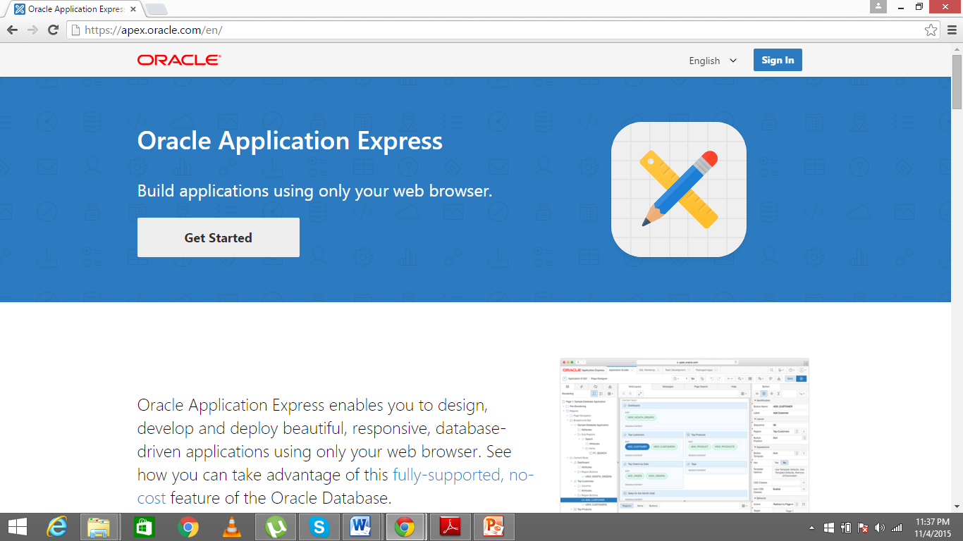
Implementing ERD using Scenario – 1

Slide 4
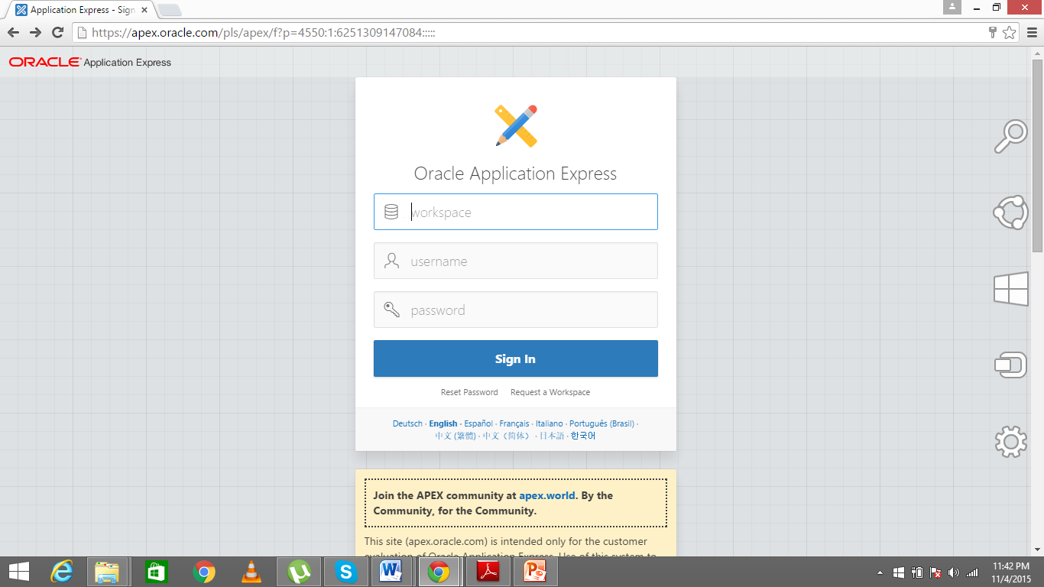
Implementing ERD using Scenario – 1

Slide 5
Introduction to Oracle 11g Cloud
Accessing Repositories
https://apex.oracle.com/en/

Slide 6
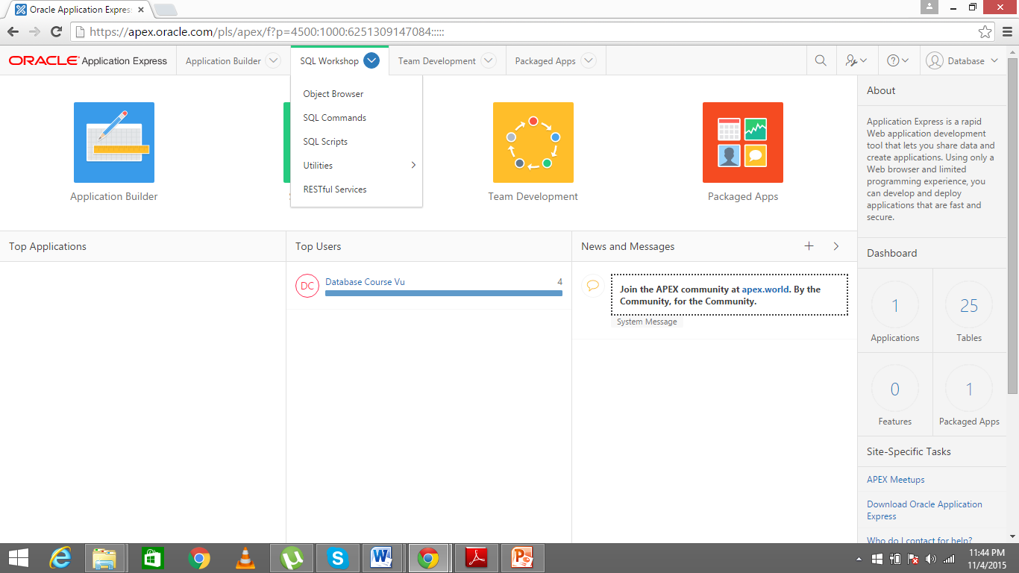
Introduction to Oracle 11g Cloud

Slide 7
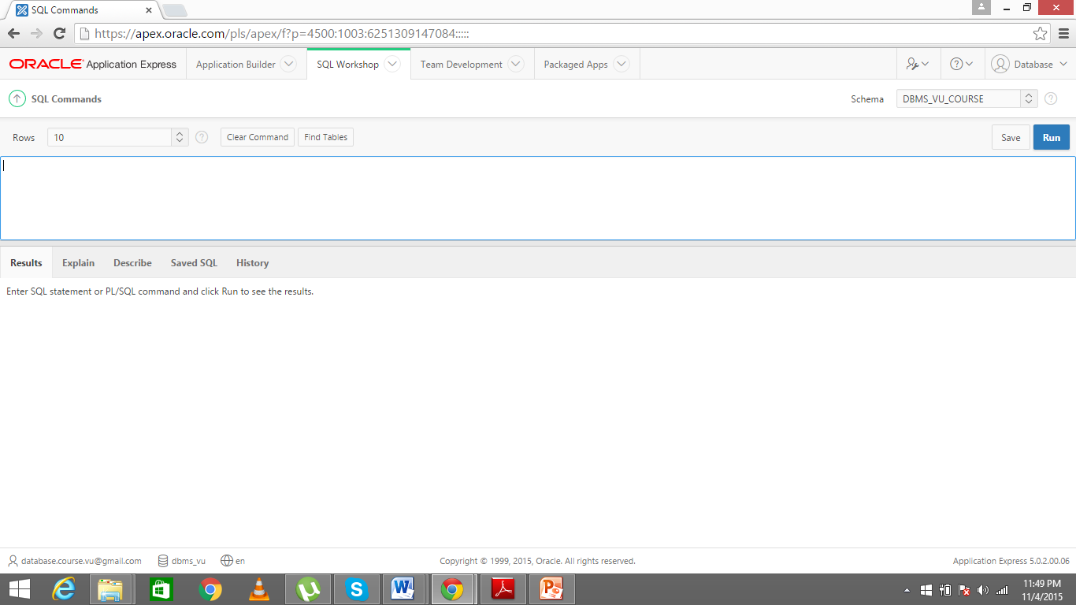
Introduction to Oracle 11g Cloud

